Slide 1


面向对象程序设计导论（Java）
阮树骅
E-mail: ruanshuhua@scu.edu.cn
Cell-p and WeChat: 13708090854

Slide 2

CONTENTS
上节回顾
高级类设计：MVC设计模式 —— 软件应用框架重用
输入输出编程：控制台、文件、数据库输入输出

Slide 3
CONTENTS
本节目录
JUnit 单元测试
Debugger 调试器
课堂实践
阅读推荐

Slide 4
Debugger 调试器

Slide 5
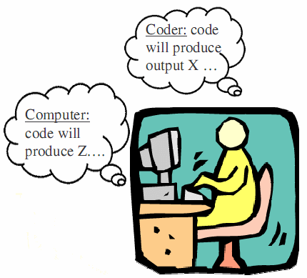
Debugger 调试器
Program errors 程序报错
Syntax errors 语法错误
Errors in code construction (grammar, types)
Detected during compilation 编译时被检出
Run-time errors 运行时错误
Operations illegal / impossible to execute
Detected during program execution 执行时被检出
Treated as exceptions in Java 做为异常处理
Logic errors 逻辑错误
Operations leading to incorrect program state 不正确的状态！！！
May (or may not) lead to run-time errors
Detect by debugging code 需要代码调试！！！
SCU_314064030 面向对象程序设计导论 © Shuhua Ruan

Slide 6

Debugger 调试器
Debugging Strategies 调试的策略（科学和艺术）
Debug with purpose 明确的目的性
Let others work for you! 使用工具
Print statements 利用打印语句输出执行结果
Focus on recent changes 增量测试/回归测试
Get some distance 远离会让自己看得更清楚
Explain it to someone else 解释给其他人听
Think ahead 更多的思考
Bugs often represent misunderstanding of a software interface
Bugs通常意味着对软件接口的错误理解
SCU_314064030 面向对象程序设计导论 © Shuhua Ruan

Slide 7
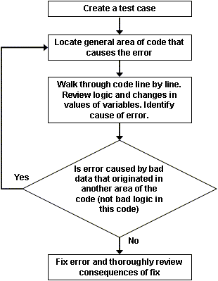
Debugger 调试器
The process of Debugging
调试的思路或步骤
Why?
Save testing time
Reproduces the error in the case
Implement the test case in a separate class or in the method main of the program being debugged.
SCU_314064030 面向对象程序设计导论 © Shuhua Ruan

Slide 8
Debugger 调试器
The process of Debugging
调试的思路或步骤
How?
A good place to start the search is the test case itself
Find the line of code in the test case where the error appears
SCU_314064030 面向对象程序设计导论 © Shuhua Ruan

Slide 9
Debugger 调试器
The process of Debugging
调试的思路或步骤
How?
Identify the code that causes the error
SCU_314064030 面向对象程序设计导论 © Shuhua Ruan

Slide 10
Debugger 调试器
The process of Debugging
调试的思路或步骤
Don't assume that the error is caused by bad logic in this code. It might be caused by bad data that originated in another area of the code.
If this is true, then locate the code where the bad data originated and repeat from step 2.
SCU_314064030 面向对象程序设计导论 © Shuhua Ruan

Slide 11
Debugger 调试器
The process of Debugging
调试的思路或步骤
The fix should not introduce new errors. The developer should understand how the fix affects other parts of the code because a fix can have unexpected side effects.
SCU_314064030 面向对象程序设计导论 © Shuhua Ruan

Slide 12
Debugger 调试器
Print statements 再次强调一下打印语句的利用
Display important information as the code executes
This information may include:
The called methods
The value of parameters
The value of loop control variables
The value of local variables
The value of instance variables
……
SCU_314064030 面向对象程序设计导论 © Shuhua Ruan

Slide 13
Debugger 调试器
Capabilities of Debugger 调试器的功能
Setting breakpoints 设置断点
A breakpoint: a marker in the code indicates the debugger to stop the execution of the program before executing a certain statement. 断点：代码中指示停止程序执行的一个标识
Breakpoint Types 断点的类型
Line 此语句执行前暂挂
Method 进入/离开此方法时暂挂
Field (Watchpoint) 监视点，成员变量被读取或修改时暂挂
Exception 捕获到Exception时暂挂
SCU_314064030 面向对象程序设计导论 © Shuhua Ruan

Slide 14
Debugger 调试器
Capabilities of Debugger 调试器的功能
Stepping through a program 单步执行程序
Resume. Continue with the execution, not single stepping. 执行至下一个断点
Step Into. Execute the current line. If current line calls a method, the debugger “steps into” the method, that is, execution moves to the called method and stops before the first line in the called method.
执行当前行，如果是方法，则进入方法并继续单步执行
Step Over. Execute the current line. If current line calls a method, the debugger "steps over" the method, that is, the method is executed and execution stops before the next line in the current method.
执行当前行，如果是方法，则进入方法并执行后继续单步执行
Step Return. Execute until current method completes and return to the calling method. Execution stops before the next line in the calling method.
执行当前方法，返回调用方法后继续单步执行
SCU_314064030 面向对象程序设计导论 © Shuhua Ruan

Slide 15
Debugger 调试器
Capabilities of Debugger 调试器的功能
Examine the data 查看数据
The debugger can display the values of the variables in the current method and class. 显示变量的值
If a variable is a compound object that contains multiple elements, the user can “open” the object and inspect the value of each element. 可以查看复合对象所包含的每一个对象
SCU_314064030 面向对象程序设计导论 © Shuhua Ruan

Slide 16
Debugger 调试器
Capabilities of Debugger 调试器的功能
Stack trace 堆栈跟踪
When a breakpoint is hit and execution is suspended, the debugger can display the sequence of called methods.
显示被调用方法序列
The user can examine the values of local variables in the called methods. 查看被调用方法的局部变量的值
SCU_314064030 面向对象程序设计导论 © Shuhua Ruan

Slide 17
Debugger 调试器
Debugger
调试器的利用
public class Debug {
private int something = 0;
public void firstMethod() {
thirdMethod(something);
something = something + 1;
}
public void secondMethod() {
thirdMethod(something);
something = something + 2;
}
public void thirdMethod(int value) {
something = something + value;
}
public static void main(String[] args) {
Debug debug = new Debug();
debug.firstMethod();
debug.secondMethod();
}
}
SCU_314064030 面向对象程序设计导论 © Shuhua Ruan
Notes:
import java.util.*;
public class Debug {
private int something = 0;
private Vector v = new Vector();
public void firstMethod() {
thirdMethod(something);
something = something + 1;
}
public void secondMethod() {
thirdMethod(something);
something = something + 2;
}
public void thirdMethod(int value) {
something = something + value;
}
public static void main(String[] args) {
Debug debug = new Debug();
debug.firstMethod();
debug.v.add("first");
System.out.println(debug.something);
debug.secondMethod();
debug.v.add("second");
System.out.println(debug.something);
}
}

Slide 18
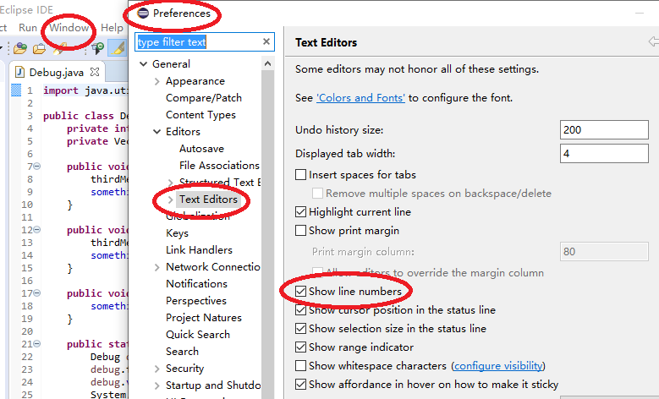
Debugger 调试器
Debugger
调试器的使用
—— 显示行号
SCU_314064030 面向对象程序设计导论 © Shuhua Ruan

Slide 19
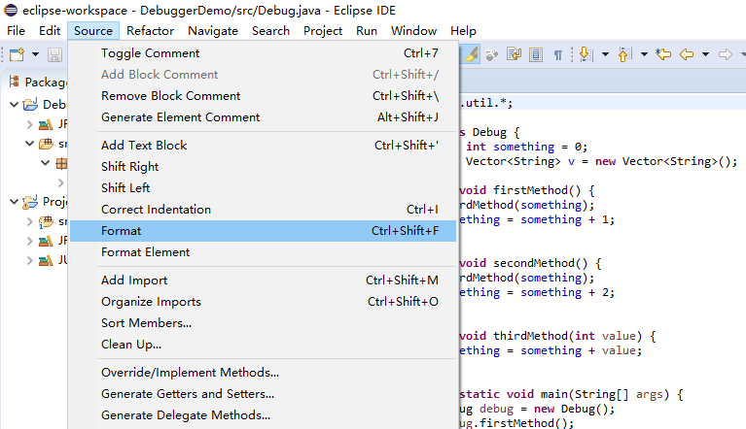
Debugger 调试器
Debugger
调试器的使用
—— 源码格式
SCU_314064030 面向对象程序设计导论 © Shuhua Ruan

Slide 20
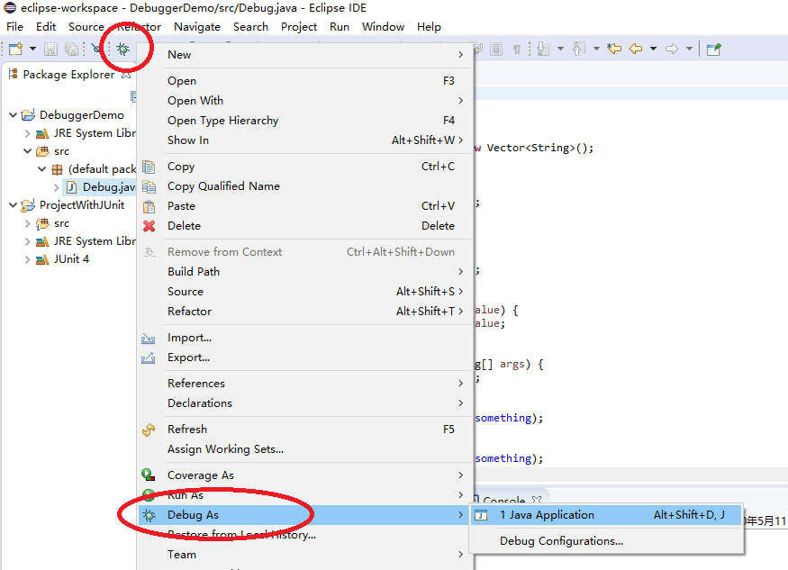
Debugger 调试器
Debugger
调试器的使用
—— 调试运行
SCU_314064030 面向对象程序设计导论 © Shuhua Ruan

Slide 21
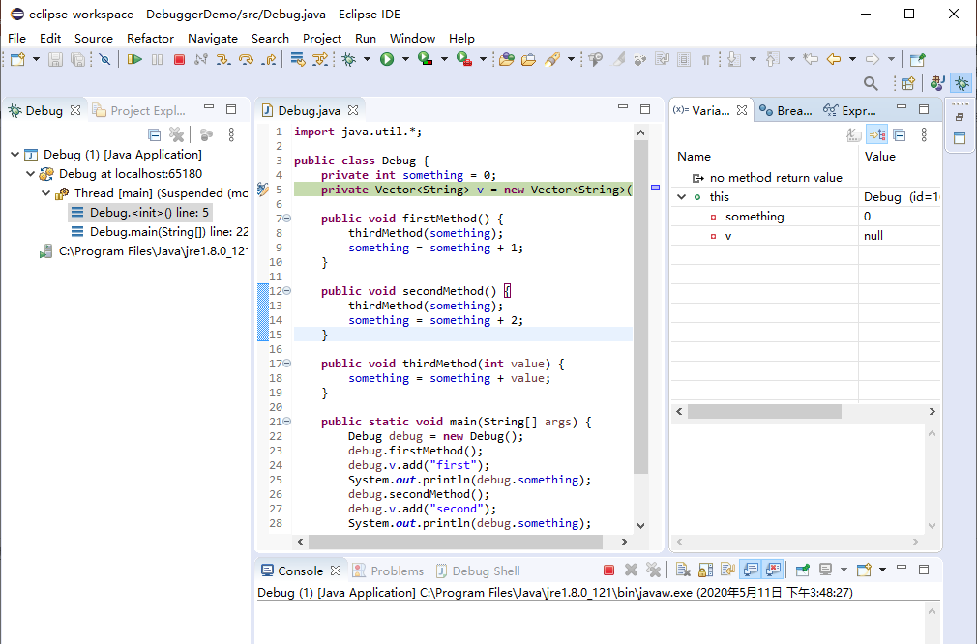
Debugger 调试器
Debugger
调试器的使用
—— 调试界面
SCU_314064030 面向对象程序设计导论 © Shuhua Ruan

Slide 22
课堂实践

Slide 23
Debugger 调试器
课堂实践：
Debugging class Employee in 1.1.9 of SSD3
_ Create a project and import Employee 导入Employee
_ Understand the requirements and implementation of Employee 理解需求
_ Execute Employee and observe the results 运行Employee并观察结果
_ Debug the Employee 调试运行Employee
_ Place a Breakpoint 设置断点
_ Monitor the Execution 监视执行并查找错误
_ Fix the errors 修正错误
SCU_314064030 面向对象程序设计导论 © Shuhua Ruan

Slide 24
阅读推荐
1、学术报告|协议模糊测试相关技术梳理： https://mp.weixin.qq.com/s/RCpAUpFEzbSewEnWpHrsqw
2、关于网络安全本质的讨论
http://www.cbdio.com/BigData/2021-03/18/content_6163533.htm

Slide 25
祝同学们学习愉快！

